Slide 1
Digital Image Processing
Image Restoration:
Noise Removal
Notes:
‹#›

Slide 2
Contents
In this lecture we will look at image restoration techniques used for noise removal
What is image restoration?
Noise and images
Noise models
Noise removal using spatial domain filtering
Periodic noise
Noise removal using frequency domain filtering
Notes:
‹#›

Slide 3
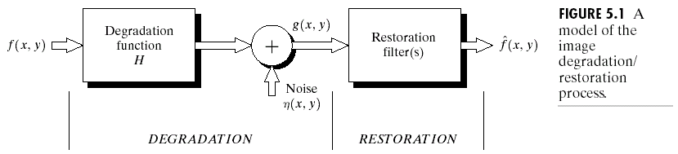

Slide 4
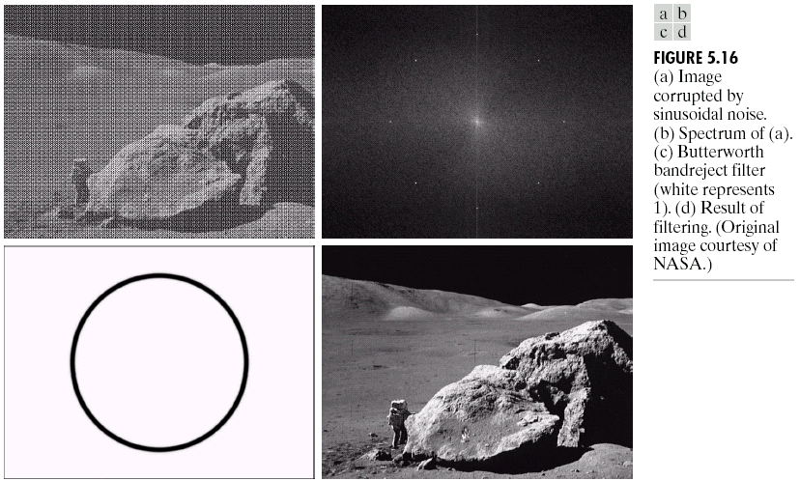
What is Image Restoration?
Image restoration attempts to restore images that have been degraded
Identify the degradation process and attempt to reverse it
Similar to image enhancement, but more objective
Notes:
‹#›

Slide 5
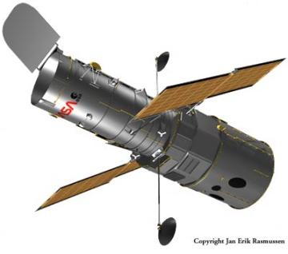
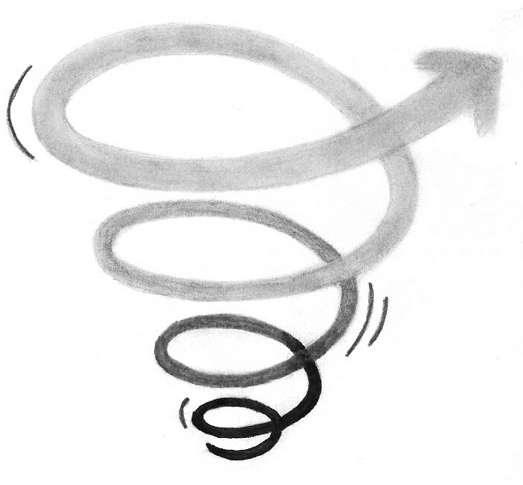

Noise and Images
The sources of noise in digital images arise during image acquisition (digitization) and transmission
Imaging sensors can be affected by ambient conditions
Interference can be added to an image during transmission
Notes:
‹#›

Slide 6
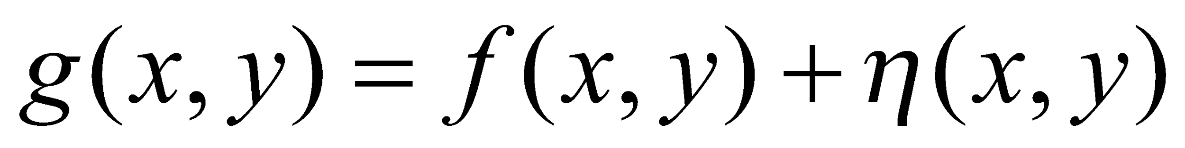
Noise Model
We can consider a noisy image to be modelled as follows:
where f(x, y) is the original image pixel, η(x, y) is the noise term and g(x, y) is the resulting noisy pixel
If we can estimate the model the noise in an image is based on this will help us to figure out how to restore the image
Notes:
‹#›

Slide 7
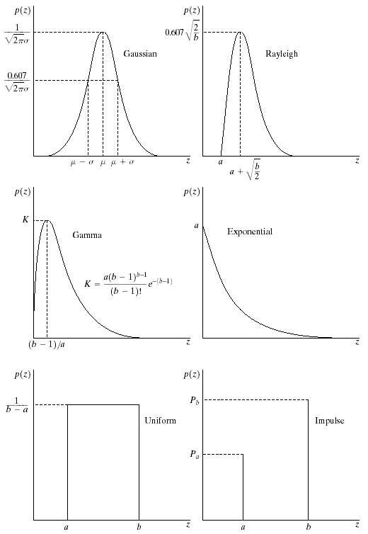
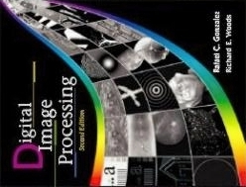
Noise Models
There are many different models for the image noise term η(x, y):
Gaussian
Most common model
Rayleigh
Erlang
Exponential
Uniform
Impulse
Salt and pepper noise
Gaussian
Rayleigh
Erlang
Exponential
Images taken from Gonzalez & Woods, Digital Image Processing (2002)
Uniform
Impulse
Notes:
‹#›

Slide 8
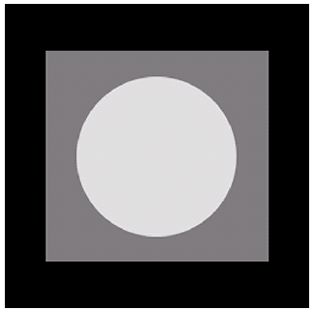
Noise Example
The test pattern to the right is ideal for demonstrating the addition of noise
The following slides will show the result of adding noise based on various models to this image
Image
Images taken from Gonzalez & Woods, Digital Image Processing (2002)
Histogram to go here
Histogram
Notes:
‹#›

Slide 9
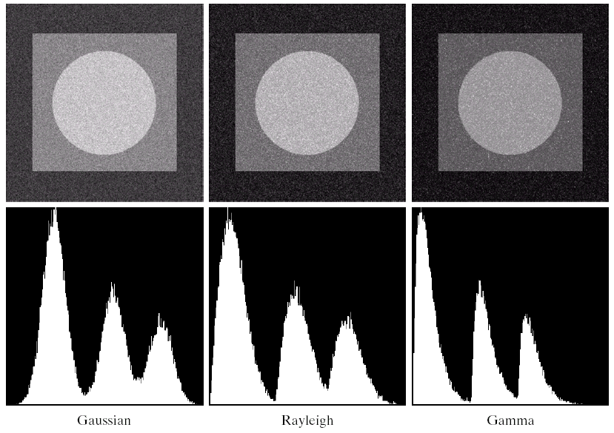
Noise Example (cont…)
Images taken from Gonzalez & Woods, Digital Image Processing (2002)
Gaussian
Rayleigh
Erlang
Notes:
‹#›

Slide 10
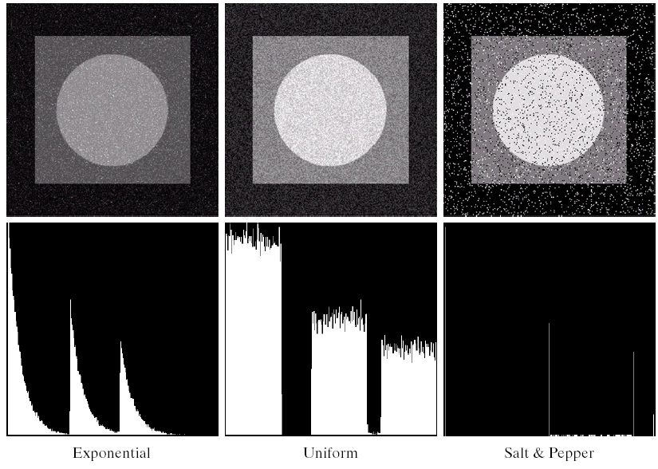
Noise Example (cont…)
Images taken from Gonzalez & Woods, Digital Image Processing (2002)
Histogram to go here
Exponential
Uniform
Impulse
Notes:
‹#›

Slide 11
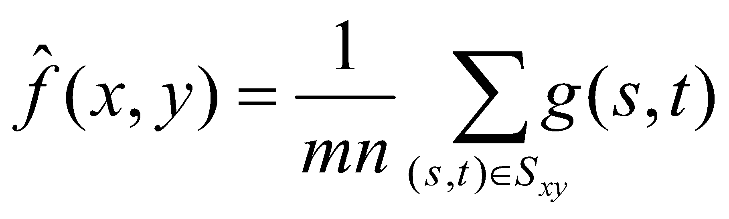
Filtering to Remove Noise
We can use spatial filters of different kinds to remove different kinds of noise
The arithmetic mean filter is a very simple one and is calculated as follows:
This is implemented as the simple smoothing filter
Blurs the image to remove noise
¹/₉ | ¹/₉ | ¹/₉
¹/₉ | ¹/₉ | ¹/₉
¹/₉ | ¹/₉ | ¹/₉
Notes:
‹#›

Slide 12
Other Means
There are different kinds of mean filters all of which exhibit slightly different behaviour:
Geometric Mean
Harmonic Mean
Contraharmonic Mean
Notes:
‹#›

Slide 13

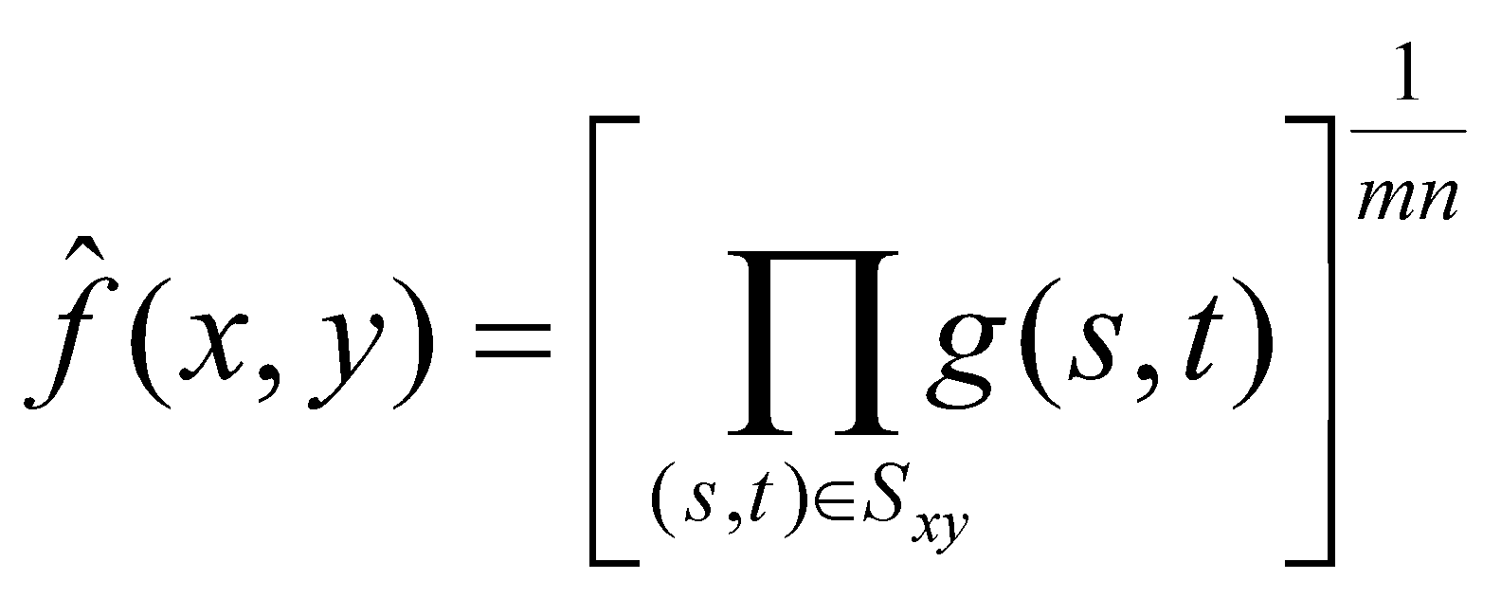

Other Means (cont…)
There are other variants on the mean which can give different performance
Geometric Mean:
Achieves similar smoothing to the arithmetic mean, but tends to lose less image detail
Notes:
‹#›

Slide 14
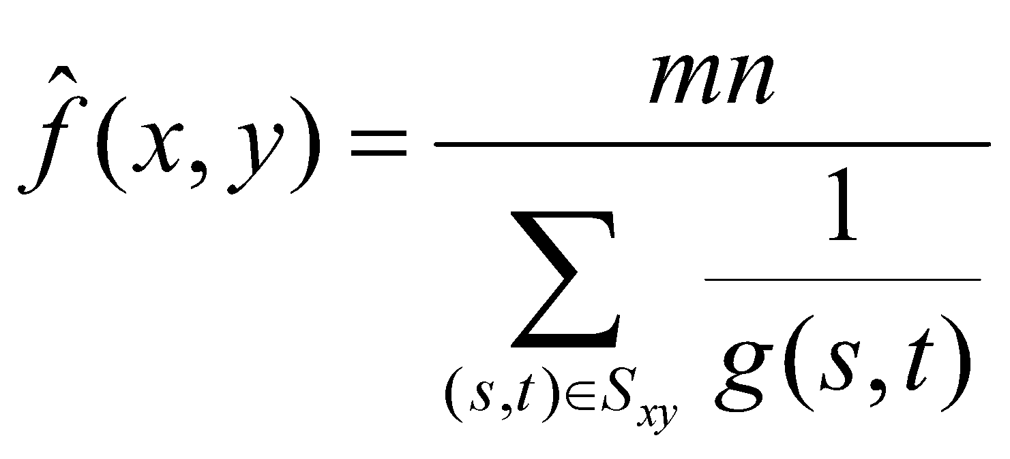
Other Means (cont…)
Harmonic Mean:
Works well for salt noise, but fails for pepper noise
Also does well for other kinds of noise such as Gaussian noise
Notes:
‹#›

Slide 15
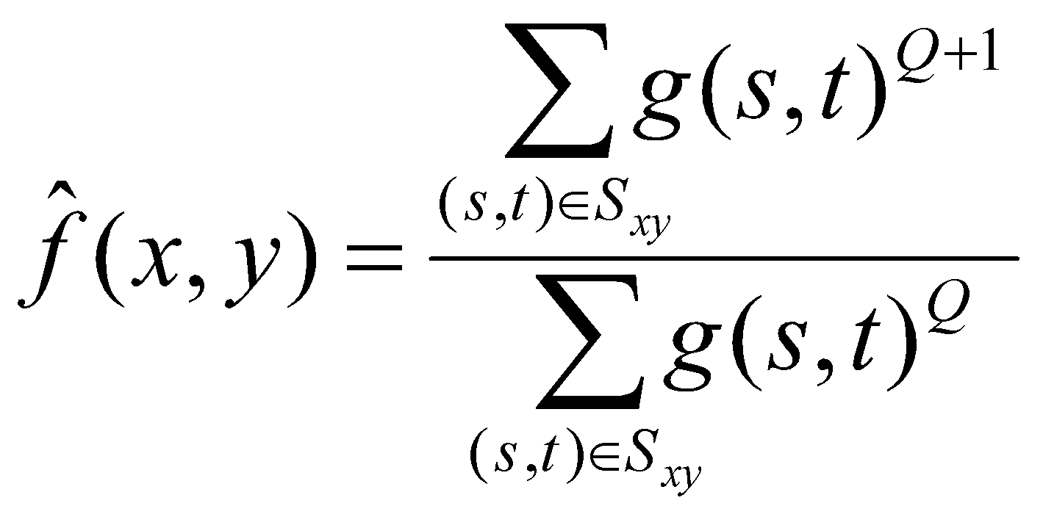
Other Means (cont…)
Contraharmonic Mean:
Q is the order of the filter and adjusting its value changes the filter’s behaviour
Positive values of Q eliminate pepper noise
Negative values of Q eliminate salt noise
Notes:
‹#›

Slide 16
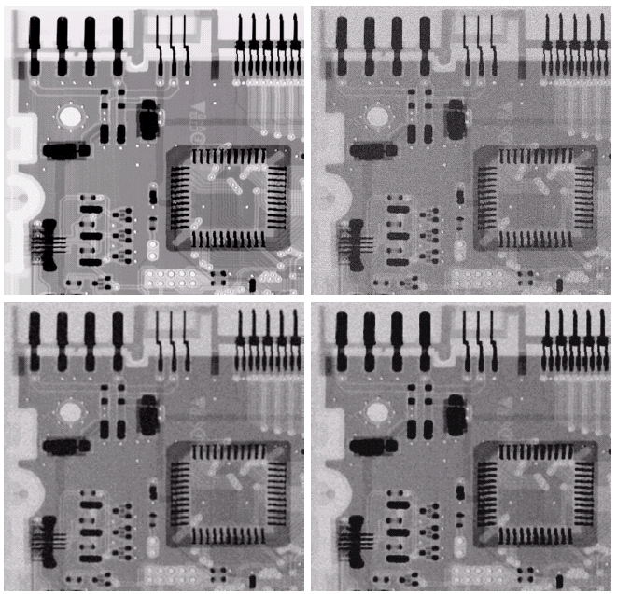
Noise Removal Examples
Image Corrupted By Gaussian Noise
Original Image
Images taken from Gonzalez & Woods, Digital Image Processing (2002)
After A 3*3 Arithmetic Mean Filter
After A 3*3 Geometric Mean Filter
Notes:
‹#›

Slide 17
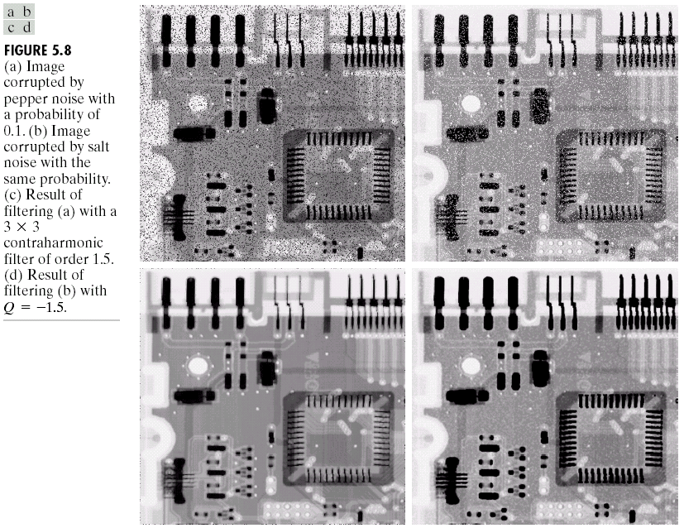
Noise Removal Examples (cont…)
Image Corrupted
By Pepper Noise
Images taken from Gonzalez & Woods, Digital Image Processing (2002)
Result of Filtering Above With 3*3 Contraharmonic Q=1.5
Notes:
‹#›

Slide 18
Noise Removal Examples (cont…)
Image Corrupted
By Salt Noise
Images taken from Gonzalez & Woods, Digital Image Processing (2002)
Result of Filtering Above With 3*3 Contraharmonic Q=-1.5
Notes:
‹#›

Slide 19
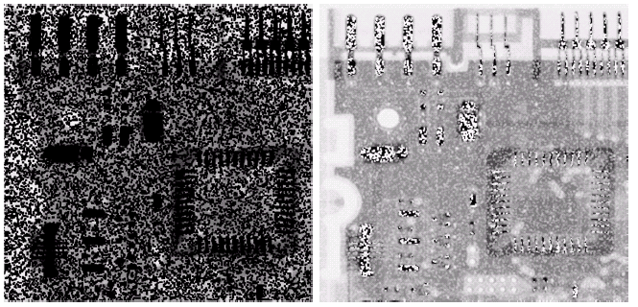
Contraharmonic Filter:
Choosing the wrong value for Q when using the contraharmonic filter can have drastic results
Images taken from Gonzalez & Woods, Digital Image Processing (2002)
Notes:
‹#›

Slide 20
Order Statistics Filters
Spatial filters that are based on ordering the pixel values that make up the neighbourhood operated on by the filter
Useful spatial filters include
Median filter
Max and min filter
Midpoint filter
Alpha trimmed mean filter
Images taken from Gonzalez & Woods, Digital Image Processing (2002)
Notes:
‹#›

Slide 21
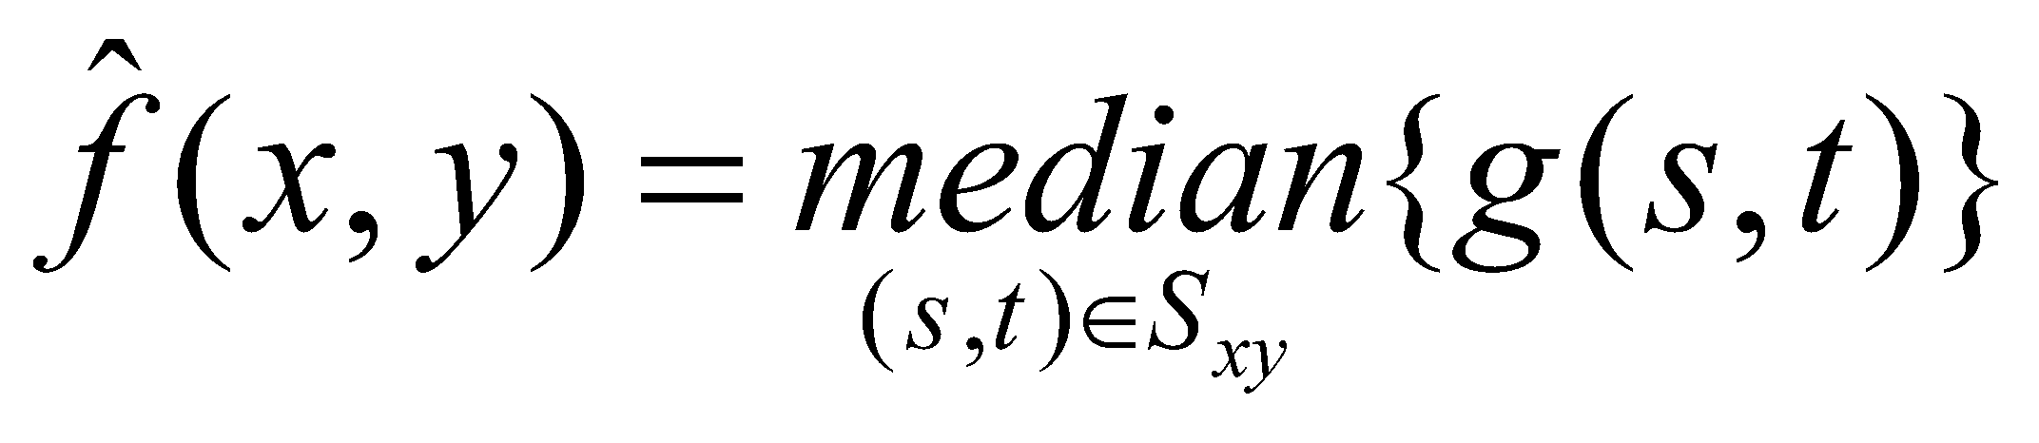
Median Filter
Median Filter:
Excellent at noise removal, without the smoothing effects that can occur with other smoothing filters
Particularly good when salt and pepper noise is present
Notes:
‹#›

Slide 22
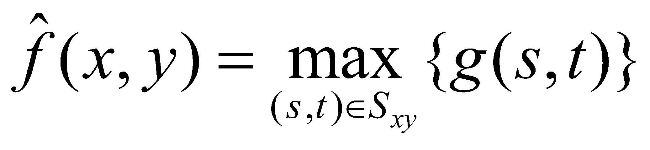
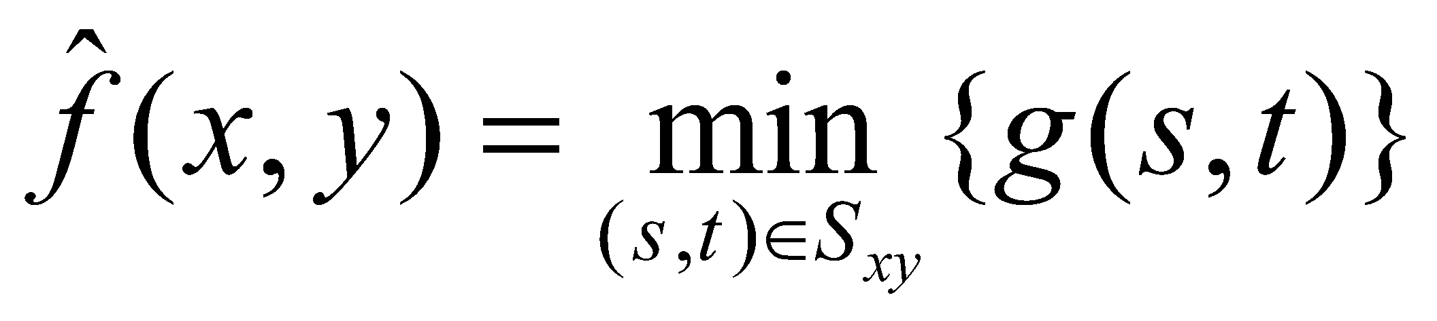
Max and Min Filter
Max Filter:
Min Filter:
Max filter is good for pepper noise and min is good for salt noise
Notes:
‹#›

Slide 23
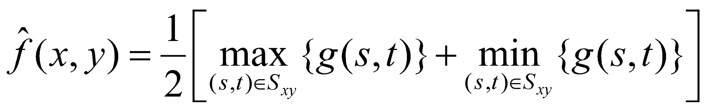
Midpoint Filter
Midpoint Filter:
Good for random Gaussian and uniform noise
Notes:
‹#›

Slide 24
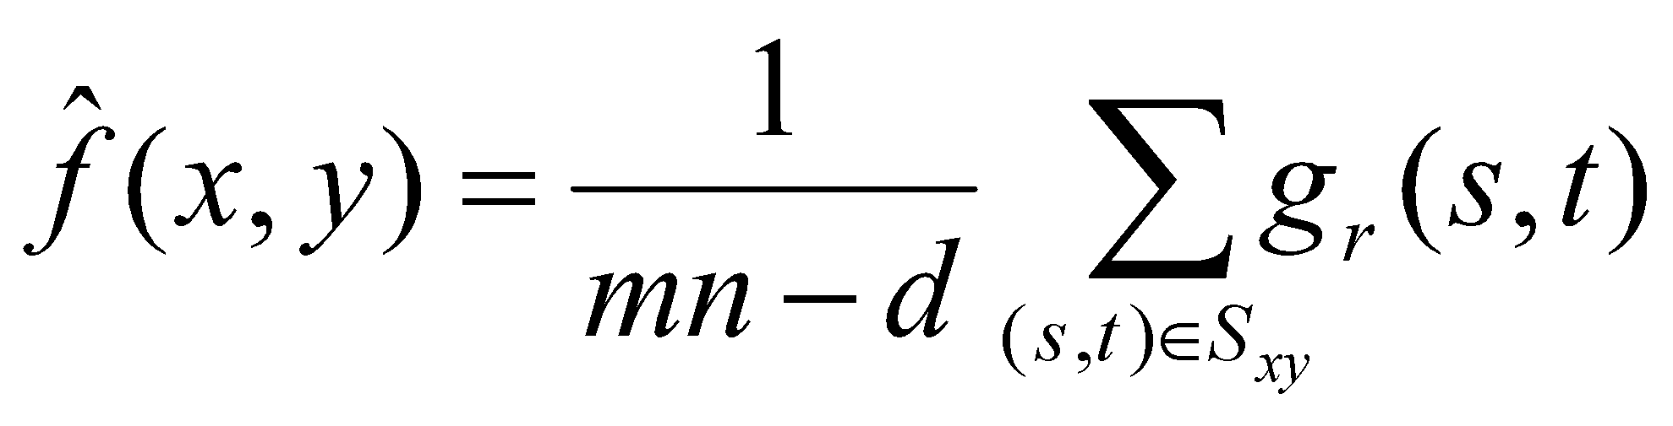
Alpha-Trimmed Mean Filter
Alpha-Trimmed Mean Filter:
We can delete the d/2 lowest and d/2 highest grey levels
So g_{r}(s, t) represents the remaining mn – d pixels
Notes:
‹#›

Slide 25
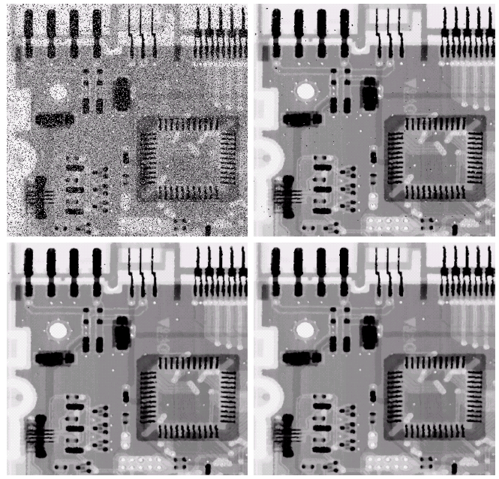
Noise Removal Examples
Image Corrupted By Salt And Pepper Noise
Result of 1 Pass With A 3*3 Median Filter
Images taken from Gonzalez & Woods, Digital Image Processing (2002)
Result of 2 Passes With A 3*3 Median Filter
Result of 3 Passes With A 3*3 Median Filter
Notes:
‹#›

Slide 26
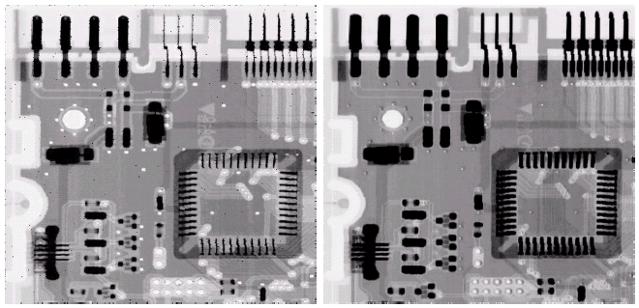
Noise Removal Examples (cont…)
Image Corrupted
By Pepper Noise
Image Corrupted
By Salt Noise
Images taken from Gonzalez & Woods, Digital Image Processing (2002)
Result Of Filtering Above With A 3*3 Max Filter
Result Of Filtering Above With A 3*3 Min Filter
Notes:
‹#›

Slide 27
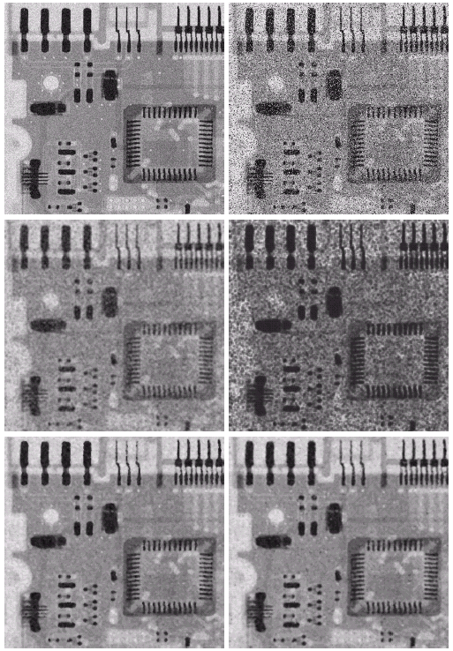
Noise Removal Examples (cont…)
Image Corrupted
By Uniform Noise
Image Further Corrupted
By Salt and Pepper Noise
Filtered By 5*5 Arithmetic Mean Filter
Filtered By 5*5 Geometric Mean Filter
Images taken from Gonzalez & Woods, Digital Image Processing (2002)
Filtered By 5*5 Median Filter
Filtered By 5*5 Alpha-Trimmed Mean Filter
Notes:
‹#›

Slide 28
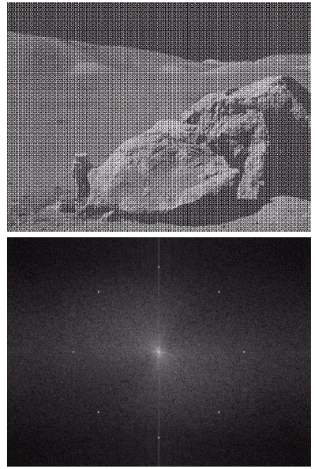
Periodic Noise
Typically arises due to electrical or electromagnetic interference
Gives rise to regular noise patterns in an image
Frequency domain techniques in the Fourier domain are most effective at removing periodic noise
Images taken from Gonzalez & Woods, Digital Image Processing (2002)
Notes:
‹#›

Slide 29
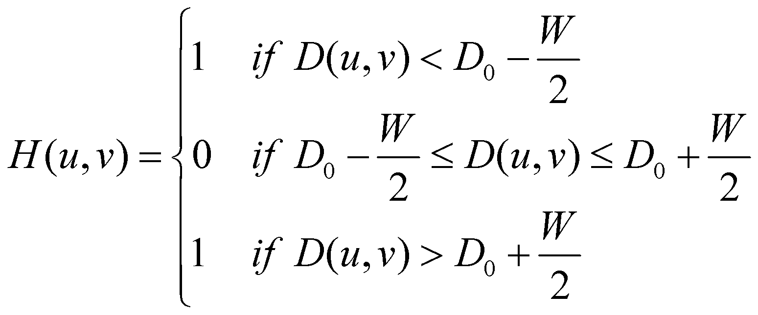
Band Reject Filters
Removing periodic noise form an image involves removing a particular range of frequencies from that image
Band reject filters can be used for this purpose
An ideal band reject filter is given as follows:
Notes:
‹#›

Slide 30
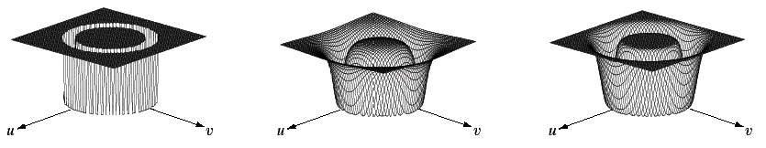
Band Reject Filters (cont…)
The ideal band reject filter is shown below, along with Butterworth and Gaussian versions of the filter
Images taken from Gonzalez & Woods, Digital Image Processing (2002)
Ideal Band Reject Filter
Butterworth Band Reject Filter (of order 1)
Gaussian Band Reject Filter
Notes:
‹#›

Slide 31

Band Reject Filter Example
Image corrupted by sinusoidal noise
Fourier spectrum of corrupted image
Images taken from Gonzalez & Woods, Digital Image Processing (2002)
Butterworth band reject filter
Filtered image
Notes:
‹#›

Slide 32
Adaptive Filters
The filters discussed so far are applied to an entire image without any regard for how image characteristics vary from one point to another
The behaviour of adaptive filters changes depending on the characteristics of the image inside the filter region
We will take a look at the adaptive median filter
Notes:
‹#›

Slide 33

Adaptive local noise reduction filter
Where g(x,y) is the processed pixel from the noisy image
Nominator is variance of the noisy image
denominator is the variance of the noisy local sub window
Ml is the local arithmetic mean

Slide 34
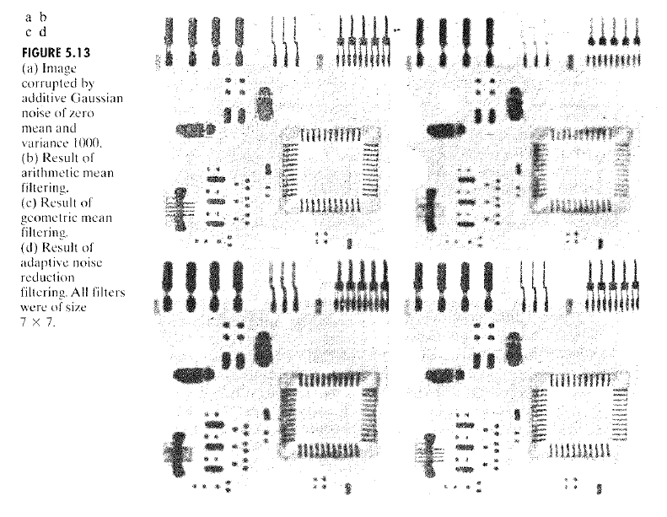
Cont….

Slide 35
Adaptive Median Filtering
The median filter performs relatively well on impulse noise as long as the spatial density of the impulse noise is not large
The adaptive median filter can handle much more spatially dense impulse noise, and also performs some smoothing for non-impulse noise
The key insight in the adaptive median filter is that the filter size changes depending on the characteristics of the image
Notes:
‹#›

Slide 36
Adaptive Median Filtering (cont…)
Remember that filtering looks at each original pixel image in turn and generates a new filtered pixel
First examine the following notation:
z_{min} = minimum grey level in S_{xy}
z_{max} = maximum grey level in S_{xy}
z_{med} = median of grey levels in S_{xy}
z_{xy} = grey level at coordinates (x, y)
S_{max} =maximum allowed size of S_{xy}
Notes:
‹#›

Slide 37
Adaptive Median Filtering (cont…)
Level A: A1 = z_{med} – z_{min}
A2 = z_{med} – z_{max}
If A1 > 0 and A2 < 0, Go to level B
Else increase the window size
If window size ≤ repeat S_{max} level A
Else output z_{med}
Level B: B1 = z_{xy} – z_{min}
B2 = z_{xy} – z_{max}
If B1 > 0 and B2 < 0, output z_{xy}
Else output z_{med}
Notes:
‹#›

Slide 38
Adaptive Median Filtering (cont…)
The key to understanding the algorithm is to remember that the adaptive median filter has three purposes:
Remove impulse noise
Provide smoothing of other noise
Reduce distortion
Notes:
‹#›

Slide 39
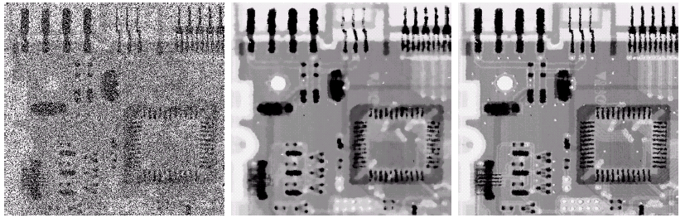
Adaptive Filtering Example
Images taken from Gonzalez & Woods, Digital Image Processing (2002)
Image corrupted by salt and pepper noise with probabilities P_{a} = P_{b}=0.25
Result of filtering with a 7 * 7 median filter
Result of adaptive median filtering with i = 7
Notes:
‹#›

Slide 40
Adaptive Mean Filtering (cont…)
Adaptive Arithmetic Mean Filtering
Adaptive Geometric Mean Filtering
Adaptive Harmonic Mean Filtering
Adaptive Contra Harmonic Mean Filtering

Slide 41
Summary
In this lecture we will look at image restoration for noise removal
Restoration is slightly more objective than enhancement
Spatial domain techniques are particularly useful for removing random noise
Frequency domain techniques are particularly useful for removing periodic noise
Notes:
‹#›

